Slide 1
Introduction to javascript
Notes:
Copyright © Terry Felke-Morris

Slide 2
Learning Outcomes
Focus shifts from HTML/CSS to JavaScript

Slide 3
Introduction to JavaScript
Focus shifts from HTML/CSS to JavaScript
JavaScript is a scripting language used to interact with web pages.
JavaScript code is typically stored in a separate files and imported into HTML.
JavaScript ≠ Java
Created in a separate file
<script src=“scripts/main.js”></script>

Slide 4
JavaScript Fundamentals
Variables in JavaScript
Let: mutable variable
let name = “Darren”;
Const: Immutable variable (constant)
const birthplace = “UK”;
“Darren”
“UK”
name
birthplace

Slide 5
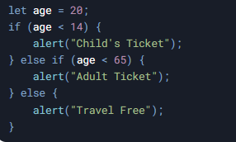
JavaScript Fundamentals
Conditional Statements

Slide 6
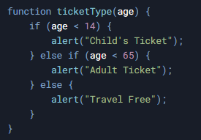
JavaScript Fundamentals
Functions

Slide 7
Modifying the Page with JavaScript
One of the functions of JS – modifying pages
The DOM (Document Object Model)
JavaScript interacts with the DOM to modify web pages.
Example: Changing the background colour of a div.
Alternative: Using querySelector

Slide 8

Event Handling in JavaScript
Reacting to User Events
Example: Adding an event listener to a button.
<button id=“btnExample”>Click</button>
function reactToEvent(){
alert(“The button was clicked!”);
}
document.getElementById(“btnExample”).addEventListener(“click”, reactToEvent);

Slide 9
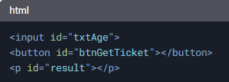
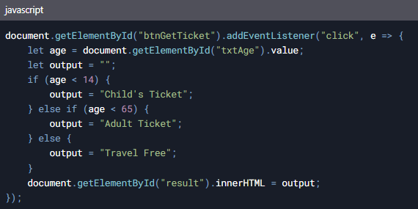
Example
Retrieving input and displaying output
Result

Slide 10
Summary
a

